Slide 1
3-Tier AWS Architecture Project Overview and Best Practices
VPC

Slide 2
3-Tier AWS Architecture Overview and Best Practices
Introduction
Purpose of the Architecture
Benefits of 3-Tier Architecture
Key Components of the Architecture
Architecture Diagram
Key Components Explained
Tier-wise Breakdown
Best Practices for Presentation Tier
Best Practices for Application Tier
Best Practices for Data Tier
Implementing Best Practices
Conclusion and Next Steps

Slide 3
Introduction
Tier Structure: The 3-Tier AWS Architecture comprises Presentation, Application, and Data tiers, ensuring clear separation of concerns.
Amazon RDS Role: Amazon RDS optimizes the Data tier, delivering enhanced scalability, security, and database management functionalities.
Benefits Overview: This architecture promotes improved application performance and streamlines deployment and maintenance across all tiers.

Slide 4
Modularity Focus: 3-Tier Architecture separates functionalities into layers, enhancing modularity and facilitating independent layer operation.
Defined Interfaces: Clear interfaces between layers improve communication, simplifying overall development, maintenance, and feature upgrades.
Easier Maintenance: Independent layer management reduces complexity, allowing for targeted updates without affecting entire application systems.
Purpose of the architecture

Slide 5

Benefits of 3-Tier Architecture
Scalability: 3-Tier Architecture allows for seamless scaling by distributing workloads across different application tiers effectively.
Flexibility: This architecture provides design flexibility, enabling the evolution of individual layers without major system overhauls.
Improved Security: Each tier can implement specific security measures, enhancing overall application protection against potential threats.

Slide 6
Presentation Tier: Serves as the user interface, handling client requests and delivering content for user interactions.
Application Tier: Processes business logic, coordinating between the Presentation and Data tiers to ensure efficient performance.
Data Tier: Manages data storage, retrieval, and manipulation, ensuring data integrity and availability across applications.
Key Components of the Architecture

Slide 7
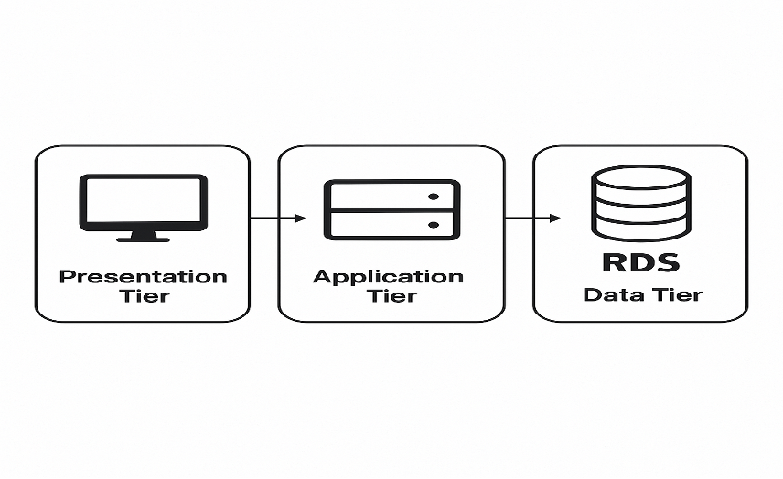
Architecture Diagram
Diagram Overview: A high-level diagram displays three main tiers: Presentation, Application, and Data, highlighting interactions.
Tier Interconnections: Illustrates functional relationships among tiers, showcasing data flow and communication between layers effectively.
Layer Functions: Defines roles of each tier, emphasizing their responsibilities in the broader architecture framework and operations.

Slide 8
Key Components Explained
Presentation Tier Role: This layer interfaces with users, translating client requests into a format for processing via application.
Application Tier Role: It executes business logic, orchestrating communication and processing between the Presentation and Data tiers.
Importance of RDS: RDS is crucial in the Data tier, enhancing structured data management, availability, and performance optimization.

Slide 9
Tier-wise Breakdown
Presentation Tier Components: Includes web servers and load balancers, ensuring efficient distribution of user requests and responses.
Application Tier Security: Utilizes API gateways and security protocols, safeguarding business logic from unauthorized access and vulnerabilities.
Data Tier Best Practices: Employs encryption, regular backups, and redundancy to ensure data integrity, availability, and disaster recovery.

Slide 10
Best Practices of the Presentation Tier
Responsive Design: Implementing responsive design ensures seamless user experiences across various devices, enhancing engagement and accessibility.
Performance Optimization: Utilizing efficient loading strategies, such as caching and content delivery networks, significantly improves user experience.
Regular Security Audits: Conducting security audits consistently helps identify vulnerabilities, strengthening the protection of user data and interactions.

Slide 11
Best Practices of the Application Tier
Responsive Design: Implementing responsive design ensures seamless user experiences across various devices, enhancing engagement and accessibility.
Performance Optimization: Utilizing efficient loading strategies, such as caching and content delivery networks, significantly improves user experience.
Regular Security Audits: Conducting security audits consistently helps identify vulnerabilities, strengthening the protection of user data and interactions.

Slide 12
Best Practices of the Data Tier
Data Integrity Maintenance: Ensuring data accuracy and consistency through validation, checks, and synchronized updates across all databases.
Performance Tuning Strategies: Implementing indexing, query optimization, and proper resource allocation to enhance database access speed.
Compliance with Regulations: Adhering to data retention regulations ensures legal compliance and minimizes risks related to data mishandling.

Slide 13
Implementing Best Practices
High Availability Importance: Ensuring system uptime through redundancy and failover mechanisms guarantees uninterrupted service delivery and reliability.
Security Practices: Adopting comprehensive security frameworks mitigates risks, protecting sensitive data through encryption and access control measures.
Scalability Strategies: Implementing elastic resource allocation enables applications to efficiently manage varying loads, optimizing performance and user experience.

Slide 14
Implementing Best Practices
High Availability Importance: Ensuring system uptime through redundancy and failover mechanisms guarantees uninterrupted service delivery and reliability.
Security Practices: Adopting comprehensive security frameworks mitigates risks, protecting sensitive data through encryption and access control measures.
Scalability Strategies: Implementing elastic resource allocation enables applications to efficiently manage varying loads, optimizing performance and user experience.

Slide 15
Conclusion and Next Steps
Overall Advantages: 3-Tier AWS Architecture ensures enhanced scalability, flexibility, security, and simplification of application management processes.
Actionable Steps: Organizations should initiate assessments, define requirements, and design architecture for effective 3-tier implementation.
Continuous Improvement: Regular review and adaptation of best practices lead to sustained performance enhancement in application delivery.

Slide 16
DAY 1

Slide 17
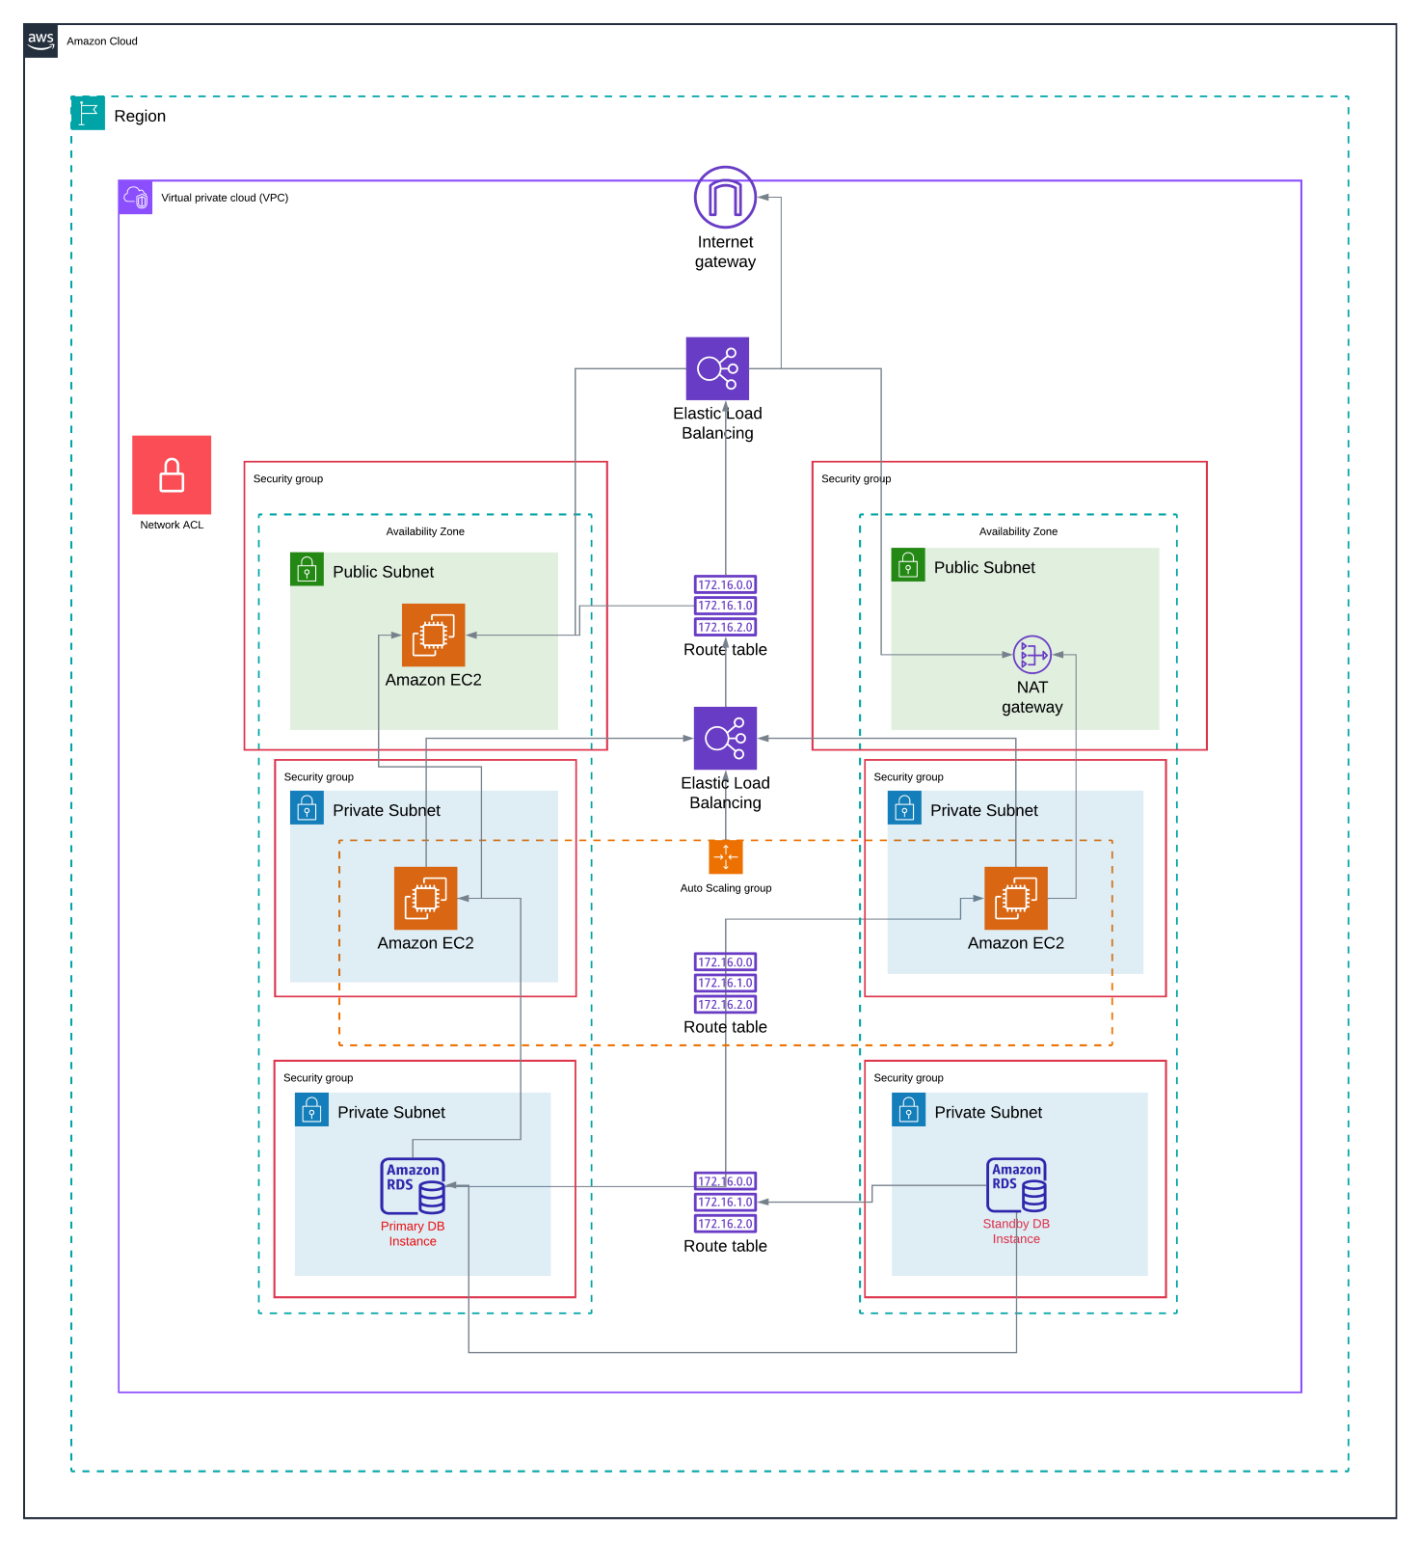

Slide 18
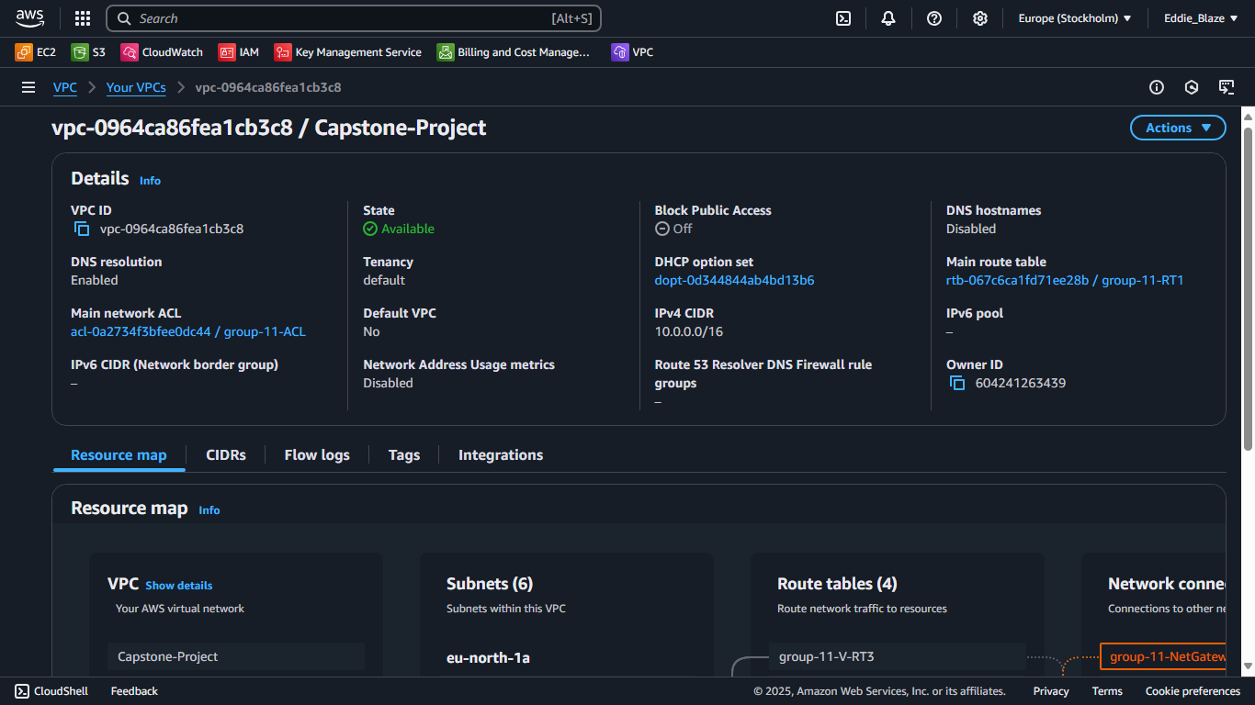
DAY 1

Slide 19
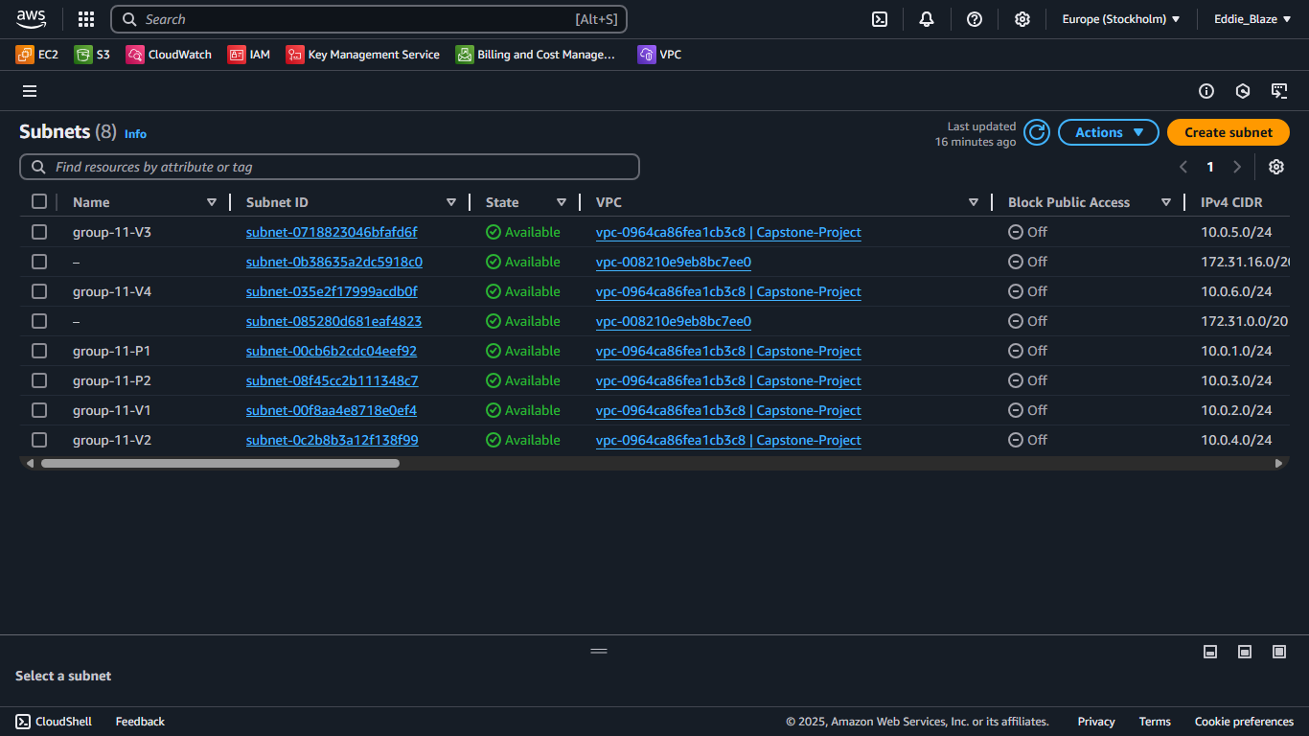
DAY 1

Slide 20
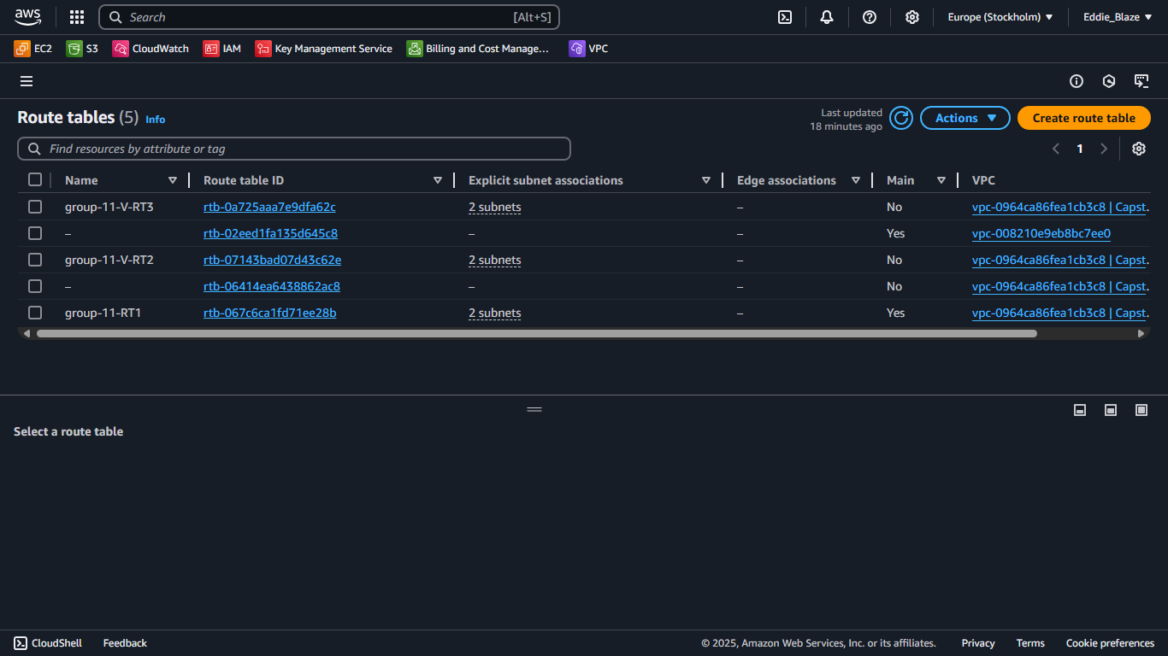
DAY 1

Slide 21
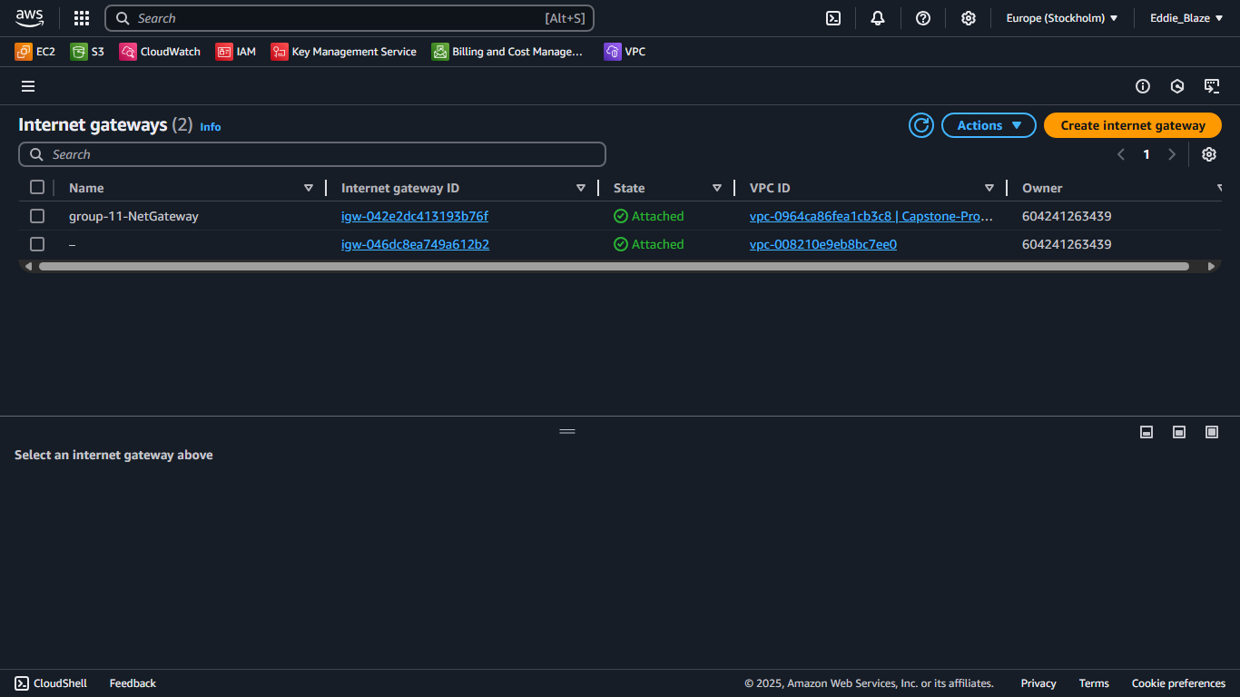
DAY 1

Slide 22
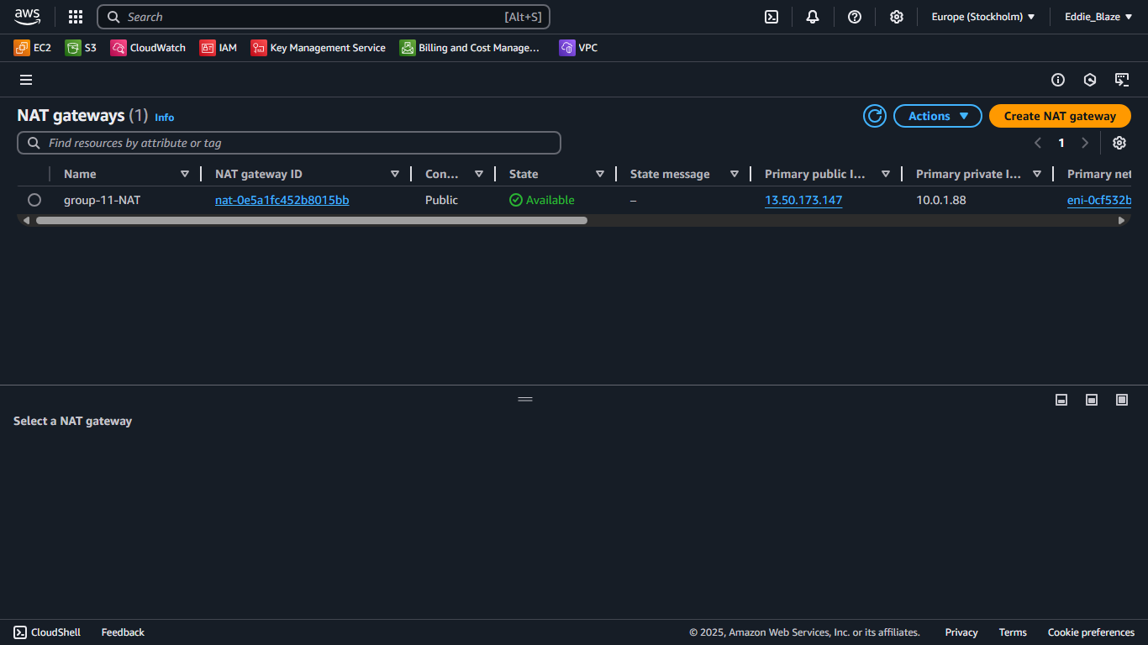
DAY 1

Slide 23
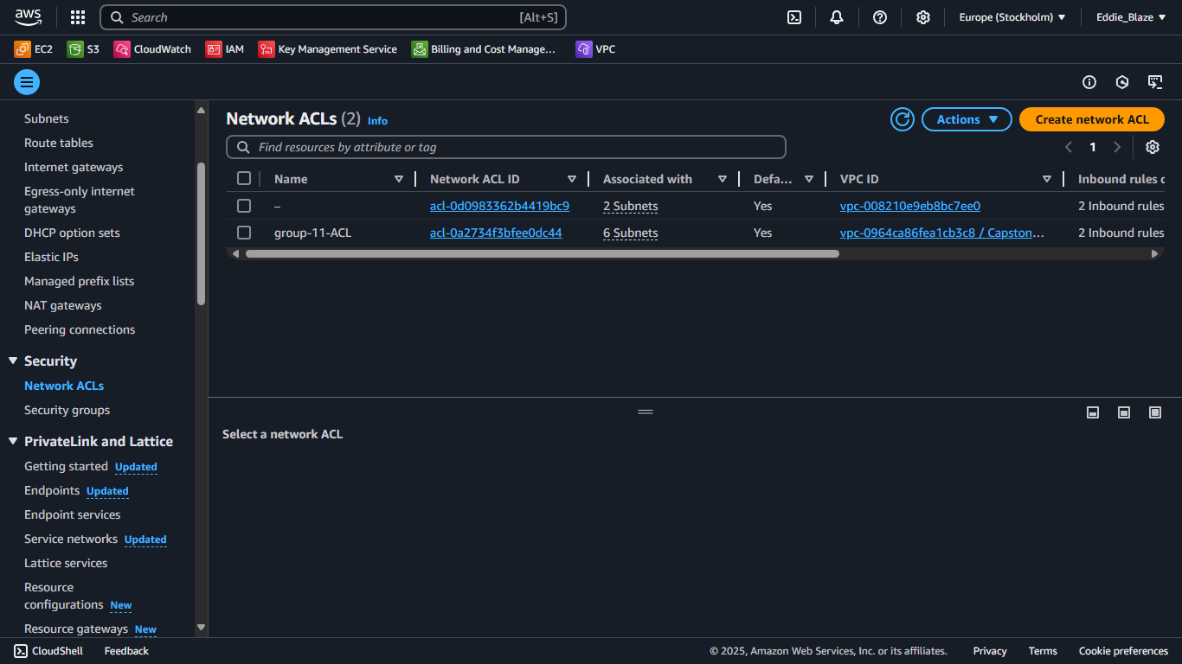
DAY 1

Slide 24
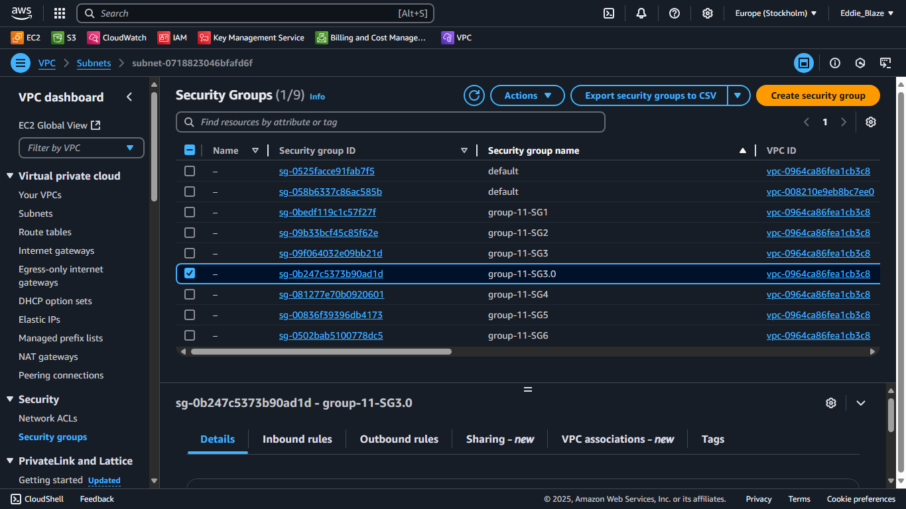
DAY 1

Slide 25
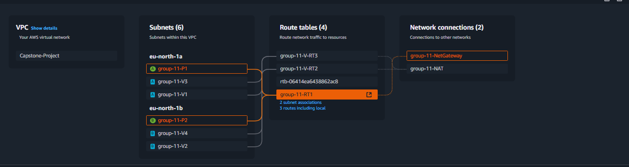
DAY 1

Slide 26
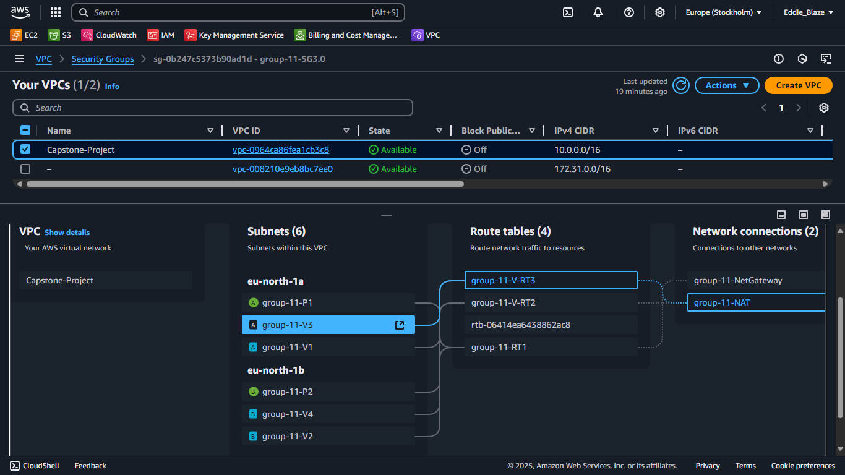
DAY 1

Slide 27
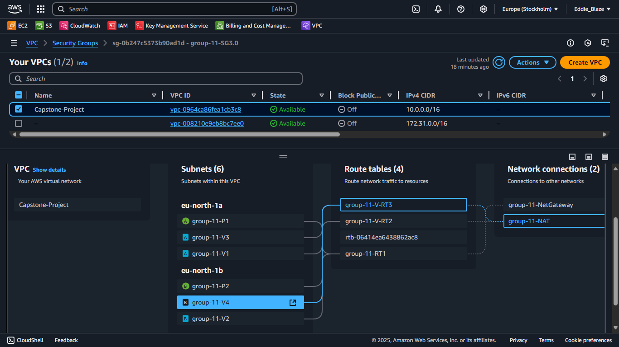
DAY 1

Slide 28
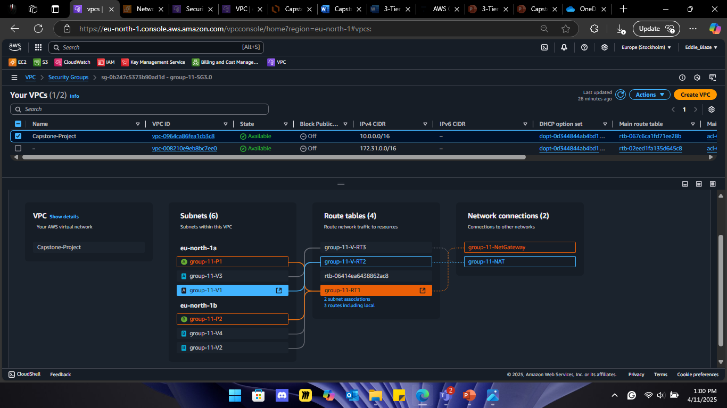
DAY 1

Slide 29
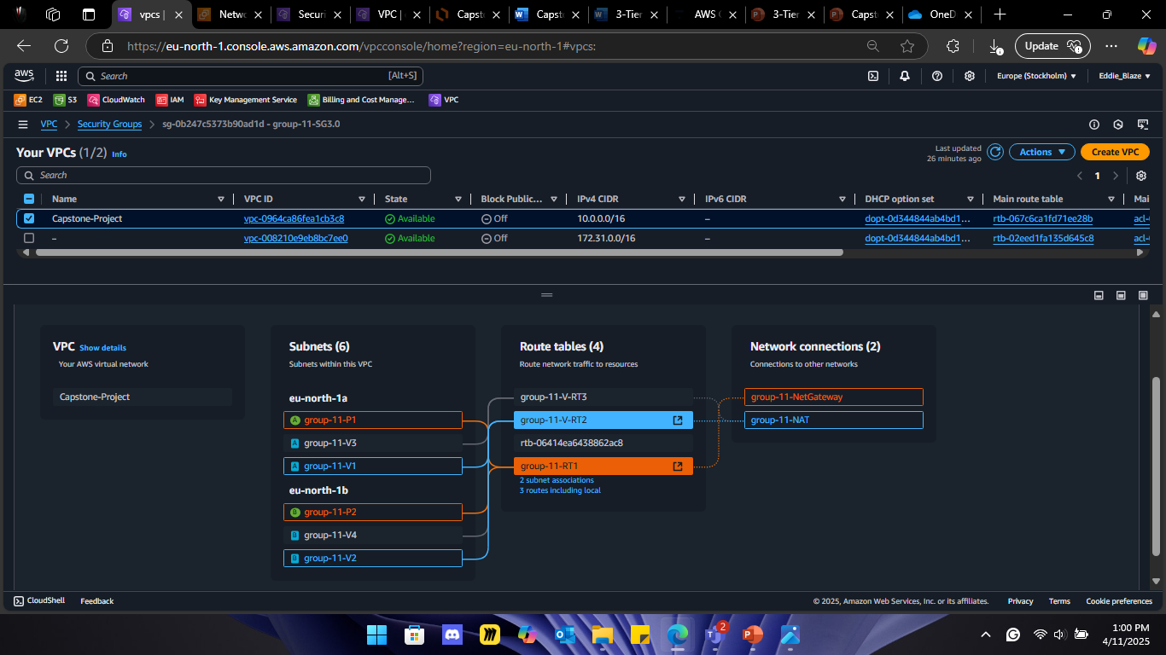
DAY 1

Slide 30
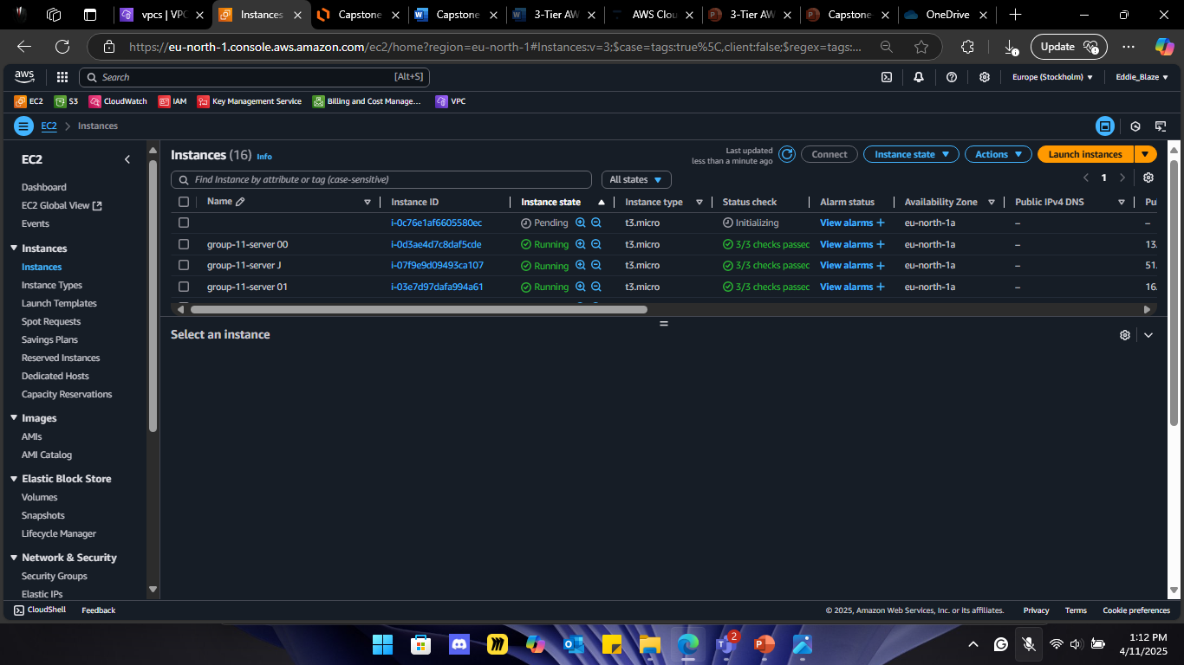
DAY 1

Slide 31
DAY 2

Slide 32
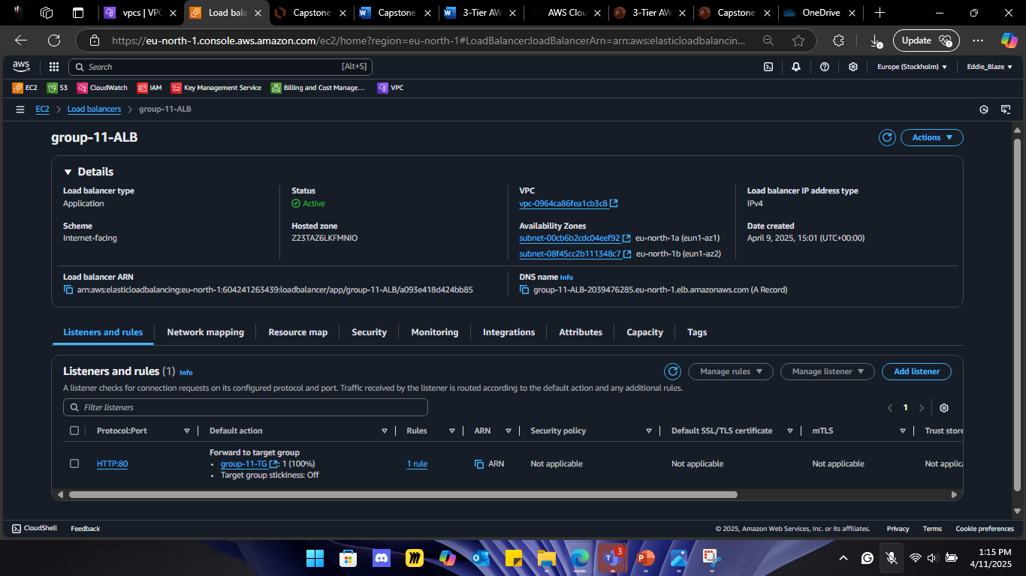
DAY 2

Slide 33
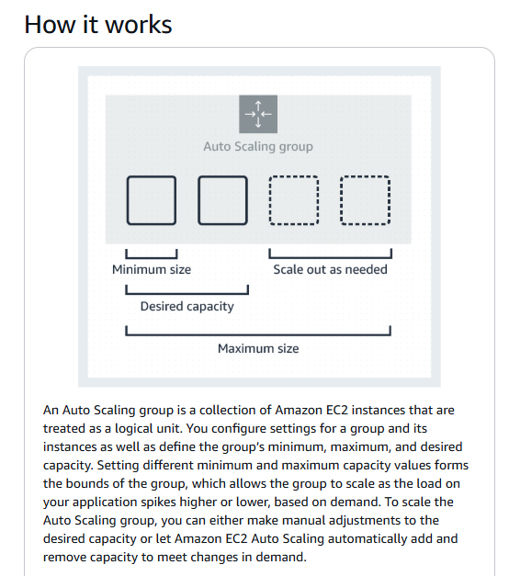

Slide 34
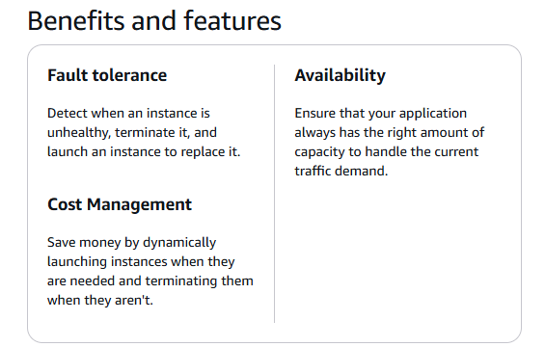

Slide 35
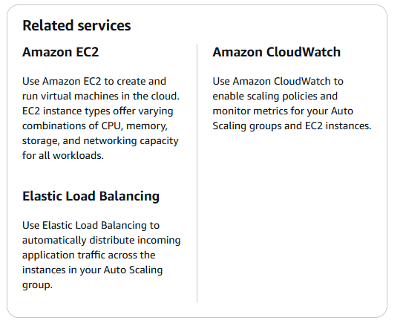

Slide 36
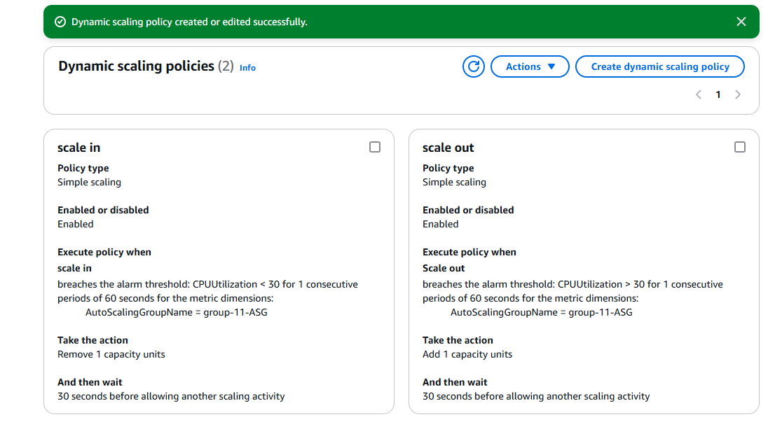

Slide 37
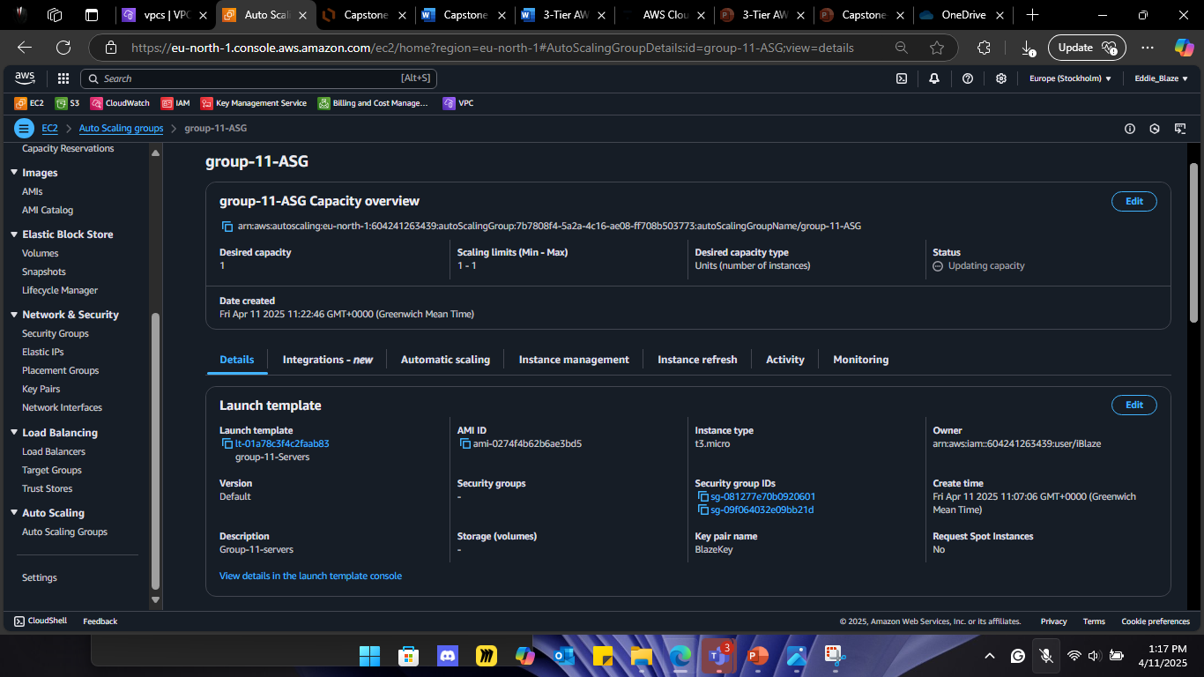
DAY 2

Slide 38
DAY 1

Slide 39
DAY 3

Slide 40
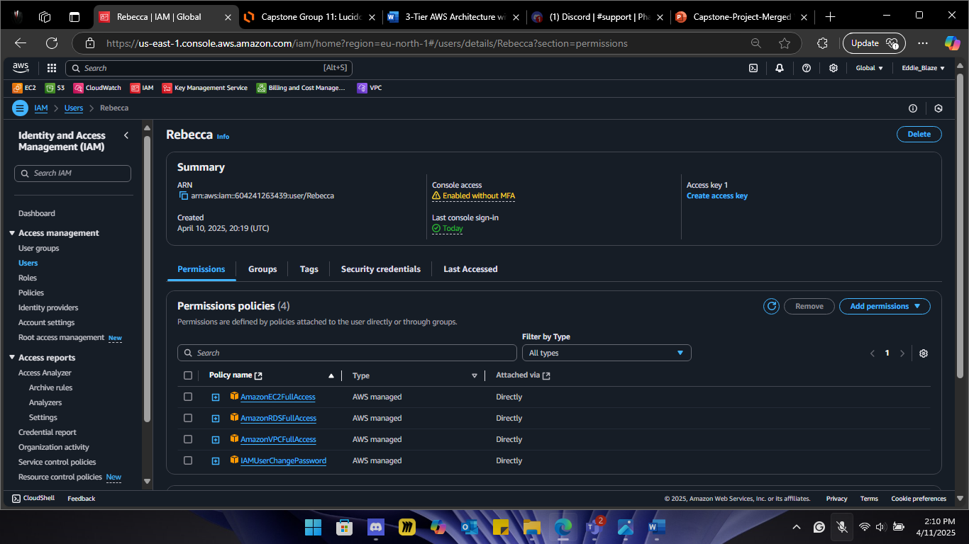
DAY 3

Slide 41
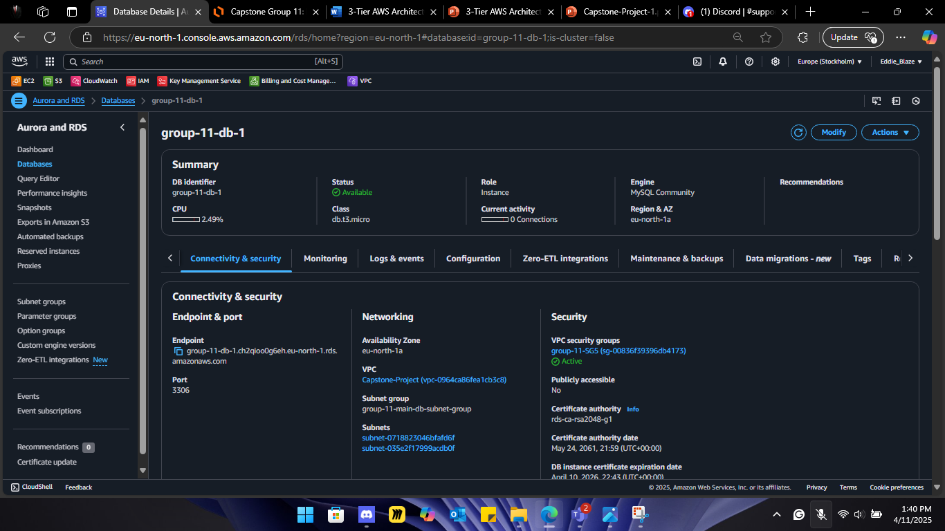
DAY 2

Slide 42
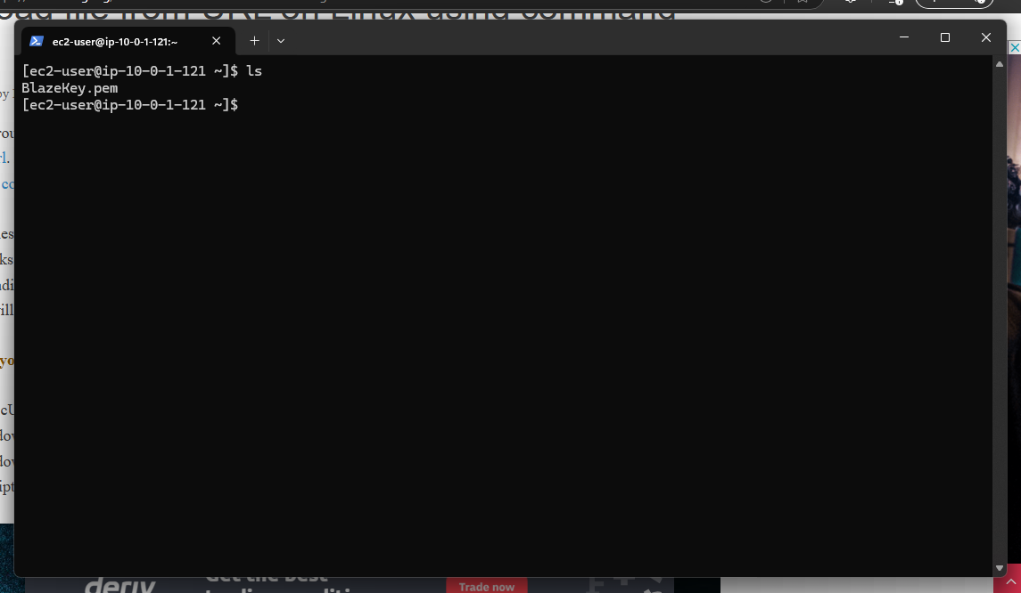
DAY 2

Slide 43
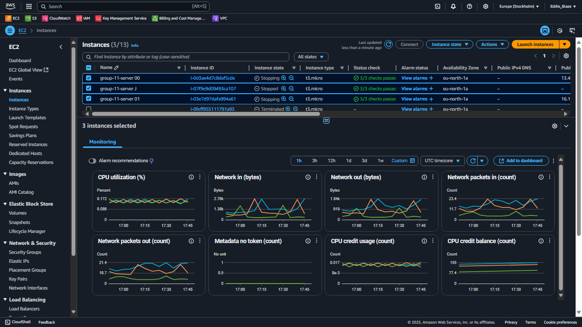
DAY 2

Slide 44
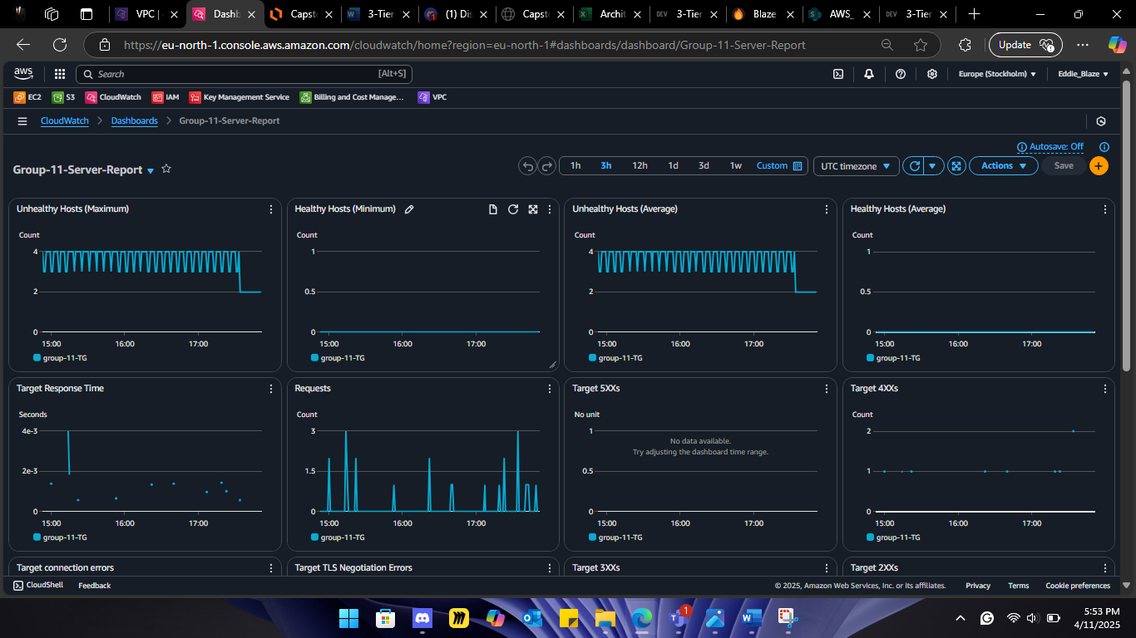
DAY 2

Slide 45
THANK YOU

